Slide 1
Town of DeWitt Police Department

Slide 2
our current structure
Chief: Chase Bilodeau
Captain: Brenton White
Patrol Lieutenant: Jerry Pace
CID/Employee Development Lieutenant: Christopher Fuller
6 Road Patrol Sergeants (2 per shift)
29 Officers
1 CID Sergeant
4 Investigators
1 School Resource Officer
Minimum Staffing of 4 Officers and a Sergeant

Slide 3
Specialty Units
Traffic Unit
Traffic Surveys, Directed Traffic Patrols
Drug Recognition Experts – Used across the County
AIT Unit
Investigates Fatal Motor Vehicle Accidents
Bicycle Patrol Unit
Directed Patrols and Special Events
Warrant Entry Unit
Evidence/Property Unit
Community Oriented Policing Unit
Employee Development and Training Unit
Firearms Unit

Slide 4
BAIL REFORM

Slide 5
Summary
Effective January 1, 2020, all forms of pre-arraignment bail will be abolished and there will be restrictions on law enforcement detaining individuals pending arraignment
A new category of “non-qualifying offenses” will be governed under a new system of pre-trial releases that will include only release on ROR or the “least restrictive non-monetary conditions.”

Slide 6
What Does This Mean?
Appearance Tickets
REQUIRED on all misdemeanors and class “E” felonies
Unless an exception applies
Rape, Criminal Sexual Act, Escape, Absconding, Bail Jumping
1 or more Warrants, Unconfirmed Identity, Domestic Violence, Order of Protection is Needed.
Must be returnable ASAP (20 day outside limit)

Slide 7
Arraignments
Courts must utilize least restrictive terms to ensure defendant’s return to court.
Meaning a court shall ROR unless the court makes “individualized determination” of flight risk.
Explanation must be ON THE RECORD or IN WRITING
Where CASH BAIL is considered, court must consider defendant’s ability to post without undue hardship.
Def. length of residence, Character, Reputation, Weight of Evidence all CANNOT BE CONSIDERED.

Slide 8
When Can Cash Bail be Requested?
All Violent Felonies
Except Burg 2nd (Dwelling)
Rob 2nd (Aided by another)
All Sex Offenses
All non-drug Class “A” felonies
Terrorism
Incest
Domestic Violence Related Contempt
Child Sexual Performance
Luring a Child

Slide 9
Other Considerations
Discourages Bench Warrants
Increased the Forms of Bail excepted

Slide 10
JUVENILES

Slide 11
Defense if Infancy
An individual less than 16, other than a Juvenile Offender, or less than 18 for a non-vehicle and traffic law misdemeanor
17 year olds are not criminally liable for non-vehicle and traffic law misdemeanors unless tied to a felony

Slide 12
Juvenile Delinquent
A person more than 7 but less than 18 who does an act which, if done by an adult would be a crime who has the defense of infancy.

Slide 13
Juvenile Offender
A child 13 – 14 – 15 who has lost the defense of Infancy because he committed the following
13 years old
Murder 2nd – Intentional
Murder 2nd – Depraved Mind
14 – 15 years old
Same as above
Murder 2nd – Felony Murder if he is responsible for the underlying felony
Murder, Arson 1st and 2nd, Rob 1st or 2nd sub 2, Kidnapping 1st, Assault 1st sub 1 or 2, Weapons on school grounds, certain Burglaries, certain Rapes, Sexual Abuse, Manslaughter 1st, Criminal Sexual Act sub 1 or 2

Slide 14
Raise the Age
Created a new category of “Adolescent Offenders” for 17 year olds on October 1, 2019.
Felonies – Youth Part Criminal Court (County)
Misdemeanors – Family Court (Except VTL)
Violations – Local Criminal Court (DeWitt/E. Syracuse)

Slide 15
Processing and Interviewing – 17 year olds and younger are now considered juveniles and must follow juvenile laws.
Conduct interviews in presence of parents or parental approval.

Slide 16
Felonies
Under 16 years of age
Designated felony arrest will be heard in the youth part of the superior court and an arraignment is required.
All other non-designated felonies are forwarded to Family Court
16 years of age
All felonies forwarded to youth part of the superior court
16 year olds may be issued an appearance ticket for “E” felonies issued to the Youth Part
Persons 16 years of age who commit a “D” felony or higher must be arraigned

Slide 17
Misdemeanors
All misdemeanors (except VTL/DWI) will go to Family Court
In short this means a Juvenile Appearance Ticket is issued, and the juvenile is released to the parent or guardian

Slide 18
Violations
Juveniles cannot be charged with Petty Offenses (Violations and Traffic Infractions)

Slide 19
Summary
Less than 16 years old
Petty Offenses (Violations and Traffic Infractions) – We cannot arrest the individual
Misdemeanors – Can arrest, but issue a juvenile appearance ticket and released to parents or guardian
Felonies – Depends on the level and severity

Slide 20
Summary
16 years old to 17 years old
Petty Offenses – Can be charged with Violations and Infractions
Misdemeanors – Can arrest, but issued a juvenile appearance ticket and released to parents or guardian
VTL Misdemeanor – Processed as an adult
Felonies - Depends on the level and severity

Slide 21
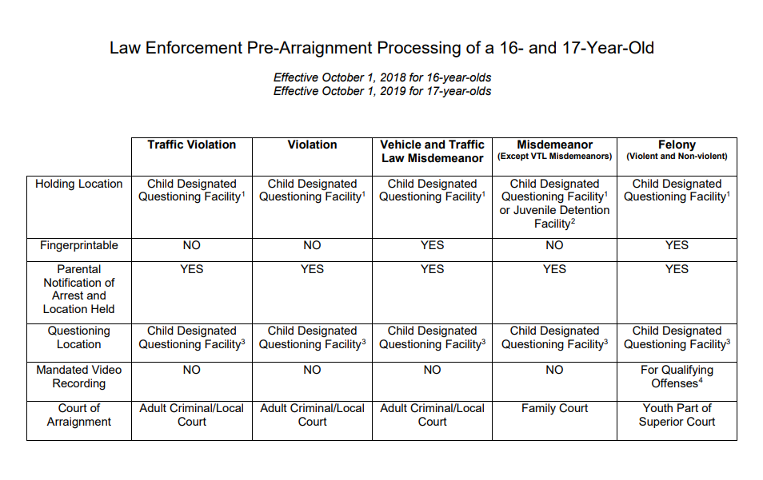

Slide 22
Useful information
Offense – is a Crime or Petty Offense
Crime – is a misdemeanor or felony
Petty Offense – is a Violation or Infraction
Harassment vs. Assault
Harassment 2nd – Violation – With intent to harass, annoy, or alarm another:
strike, shove, kick, etc.
Assault 3rd – A Misd.
Intend Physical Injury and Cause Physical Injury.
Recklessly Cause Physical Injury.
Through Criminal Negligence Cause Physical Injury by Deadly Weapon or Dangerous Instrument.

Slide 23
Larceny vs. Trespass vs. Criminal Trespass vs. Burglary vs. Robbery
Larceny – A Misd. – Stealing of Property, less than $1000
Trespass – Viol – Knowingly and Unlawfully Enter or Remain in a Premise
Criminal Trespass – B Misd. – Trespass in a building or Fenced or Enclosed Real Property
A Misd. – If it is a Dwelling
Burglary – D Fel. – Knowingly and Unlawfully Enter or Remain in a Building With the Intent to Commit a Crime There In
C Fel. – If it is a Dwelling
Robbery – D Fel. - Forcibly Stealing Property

Slide 24
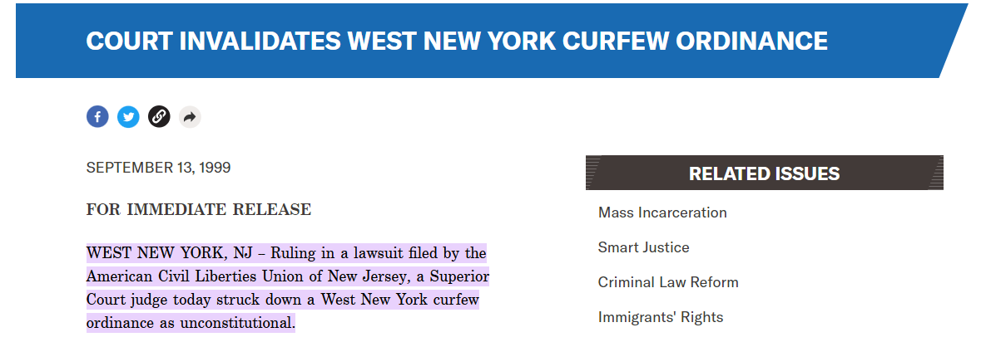
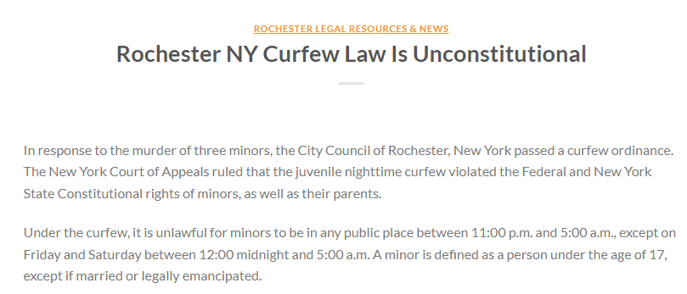
Curfew Local Law
Under the First Amendment, people are guaranteed, including teen-agers basic freedoms and rights all over the United States. Under the 14th Amendment, the Constitution respects everyone's rights no matter how unreasonable they may be. Therefore, curfew laws violate our Constitutional rights, and that is intolerant.

Slide 25
Village of east syracuse

Slide 26
Village of East Syracuse by the numbers
 | 2017 | 2018 | 2019 | 2020 | 2021 | *2022*
Total Calls | 6095 | 5816 | 5505 | 4446 | 5942 | 2017
Disp. Calls | 3161 | 3311 | 3167 | 2971 | 3482 | 1103
Stops | 1673 | 1094 | 929 | 506 | 663 | 406
PCHK | 1261 | 1411 | 1409 | 969 | 1797 | 508
Arrests | 174 | 209 | 245 | 194 | 193 | 81

Slide 27
2019 vs. 2022 Jan. 1st – April 26th
 | 2019 | 2022
Homicide | 0 | 0
Shots | 0 | 0
Robbery | 1 | 2
Burglary | 3 | 4
Larceny | 61 | 62
Stolen Vehicles | 0 | 5
Sex Crimes | 0 | 1
Total | 1736 | 2017

Slide 28
The Village of East Syracuse is encompassed within a “Post” of the Town of DeWitt.
The Town of DeWitt is made up 4 Posts, plus what we call Assist Posts, and Supervisor Posts.
Each of the main 4 posts are staffed 24 hours a day, 365 days a year.
In addition to this, the Town of DeWitt PD has 4 Investigators, 1 CID Sgt., and 1 CID Lt that can respond when needed.
The posts are divided so that each post responds to approximately 25% of the dispatched calls.
No post get less coverage or service than another post

Slide 29
The Town of DeWitt Police Department currently stations 1 Officer and 1 Lieutenant in the Village Hall, and routinely conducts trainings within the Village Hall.
In the spring and summer we routinely conduct bicycle details specifically within the Village of East Syracuse
We also conduct directed details throughout the year which may consist of additional patrols, unmarked patrols, foot patrols, and surveillance operations.

Slide 30
Questions and Comments

